Slide 1


District 13 Post Adjutant Course
Wayne Heimsoth (District Adjutant)
Arturo Thiele-Sardina (District 3rd Vice Commander and Training Officer)
12 April 2025
Notes:
Good morning and welcome to the District 13 Adjutant Course
-Wayne and I will be your instructors today
-We will split this course into two parts with a break or two included
-Please ask questions, we may not have the answers but am sure someone here has the answer and if not we’ll find out and send the info to all of you after the class

Slide 2
Overview
Course Objectives
Getting started
Post Adjutant Tools
Post Adjutant’s Manual
Mandatory Annual Reports
MyLegion.org
Meeting minutes
Notes:
- Becoming a Post Adjutant can sometimes be a challenging task for a variety of reasons.
- All posts are different, as we will discuss in a few minutes. - We will focus on these areas listed on the slide. We certainly cannot go into depth in each of these areas, but we will cover those thing you should know and learn to make sure your term as Adjutant is a success.

Slide 3
Course Objectives
Understand the importance of reports/reporting
Understand the information available in manuals and other important tools
Understand the purposes and uses of myLegion.org
Notes:
This course is designed NOT on surviving your term as a Post Adjutant, but to establish a foundation for an effective and successful term in the position.
A successful Post Adjutant is focused on being a leader, not a caretaker, of the Post.
Leaders look to the future, work on continuous improvement of post operations and program management, and take pride in moving the Post forward. Caretakers merely try to survive from one year to the next.

Slide 4
ADJUTANT
“My comrade, you have chosen to assist your Commander in the wise and effective administration of that office and to serve not only your fellow Legionnaires, but also those whose relationship to the organization has led them to look for us for guidance and relief. You will find the duties many, varied, and at times taxing of your crowded hours and resources. The successful accomplishment of our programs depends, to a great extent, upon you and your performance of the duties of your office.”
--Charge from the installation ceremony
Notes:
This is directly taken from the Officers Guide and Manual of Ceremonies. It is what is the charge installed in you for during the installation ceremony. Take a few minutes to look it over.
What does it mean to you?

Slide 5
Why are we here?
Notes:
We will discuss some of the tools and publications that can be extremely helpful to you – and in the process make you look knowledgeable and confident in front of your membership.
An important goal is to motivate and develop leaders to take the organization into the future

Slide 6
Developing Legion Leaders
An important goal of The American Legion is to motivate and develop leaders to take us into the future
Tale of woe from the past – “I brought my computer (or tablet) to a meeting and was immediately asked to be the Adjutant.”
Tale of success from the future - “I felt confident and prepared to become the Post Adjutant.”
Notes:
Is anyone already the an Adjutant?
Who felt they were already prepared to be the Adjutant?
Discuss any Tales of woe or success

Slide 7
The Path To Success
Successful Post Adjutants become successful/enthusiastic District Adjutants or Assistant District Adjutants
Successful District Adjutants become key leaders at District, Department level or beyond
We need great leaders at all levels of our organization
It all starts at the Post level
Notes:
- Successful post Adjutant are proud of what they have done, and are more likely to be more enthusiastic and motivated to contribute to the Legion at a higher level of the organization – move up the chain so to speak, even though that is not the frame of mind we want to establish. A more accurate phrase would be to “contribute beyond the post level.”
- Successful post Adjutants generally become knowledgeable and successful County Adjutants. Those County Adjutants become our effective District Adjutants, who in turn often contribute at position at Department level or even higher.
- We need solid leaders at all levels of the Legion, and we increase our chances of having these leaders by preparing them early for success.
- This course is our first step focusing on specific roles and positions in the Legion. Leadership and Legion effectiveness both start at the post level.

Slide 8
Getting Started
Notes:
-Let’s get started

Slide 9
Facts To be Recognized
There are over 12,000 AL Posts nationwide, and 12 in our District and NO TWO ARE ALIKE
Differences in size, wealth, assets, history, location, member attitudes, community support, personalities
Being Post Adjutant is similar no matter what Post it is with the only difference being that in some Posts the Adjutant and Finance Officer are combined
Notes:
The Legion was created with the local Post as its foundation. Over the years posts have developed many of their own traditions and programs in the community. It is a fact that no two posts are alike, and we have over 12,600 posts in The American Legion. They range in size from less than 20 to over 6,000.
-Here in our District we have 12 Posts ranging from Post 375 with 27 members to Post 419 with 355 members.
-Over half of them have their own facilities, other lease or borrow space. Some are rather wealthy – others have few tangible assets.
They all have their own histories, traditions, and personalities. One size does not fit all.
Question: What is unique or different about your post that you have noticed?

Slide 10
The Ideal Adjutant?
What are some of the traits or attributes that the ideal adjutant should possess?
Notes:
Ask what some of the traits, attributes, and skill of the ideal adjutant should be?
- Have someone write down the replies and then read off the list when all inputs have been made?
Discuss the results
Does anyone actually have all the attributes they described? Probably not

Slide 11
Suggestions For The Adjutant
The Post Adjutant’s Manual, page 3, says:
The only indispensable qualifications are honesty and willingness.
Notes:
Honesty and willingness are a great starting point for a new post adjutant.
Many tools are available to help an honest and willing Legionnaire become a proficient Adjutant, and a critical member of the Post leadership team
Now let’s look at some of those tools

Slide 12
Post Adjutant Tools
Post Adjutant’s Manual
Public Relations Toolkit
District and County Commanders Guide
Four Pillars booklet
Notes:
This is a list of resources, in no particular order, of the tools available to assist you in your job duties.
-The Post Adjutants Manual is probably the key tool and reference manual

Slide 13
Post Adjutant’s Manual
The adjutant’s job-
Like the first sergeant of the company
Typically retained for several years
Provides continuity
Personnel officer
Keeps records and minutes of meetings
Provides direction to new officers and committees
Notes:
Same position in the Post as the secretary of an organization and a bit more
All post activities revolve around the Adjutant
Good adjutants stay for many years. This helps to provide continuity when other officers rotate offices. District 13 had Gene Fanucci as their adjutant for many years.
How long have each of you been Adjutants?
Commander navigates the ship, but the adjutant is the engineer who runs the ship’s machinery and keeps the vessel on an even keel.
Point of contact for individual members of the post

Slide 14
Post Adjutant’s Manual (2)
Past post records will give insight into the post’s policies and traditions
Department headquarters and staff can be most useful tools
Retain documents in a way that is useful to everyone
Written
Digital
Posted on website
Remind the finance officer and commander that state and federal forms need to be filed
Notes:
Past records include constitution and by-laws, minutes of meeting, reports of officers and committees
Documents can be retained electronically, however paper records should also be retained. Why?

Slide 15
Meeting Minutes and Agenda

Slide 16
Meeting Minutes
Written/recorded documentation that is used to inform attendees and non-attendees about what was discussed and what happened during a meeting
Document the key ideas or discussion points that led to a decision
Serve as a reminder of the commitments team and committee members made during the meeting
16
Notes:
Ensure the post Bylaws indicate how long the meeting minutes are to be held. It is recommended they are held in written form for five years or more.

Slide 17
Motions And Discussion
Document the following:
The names of the people proposing any action, stating an option or making a motion
Take down word-for-word any motions, resolutions, amendments, decisions or conclusions
Who seconded the motion
Whether the motion is approved, defeated, or withdrawn
What assignments were made and to whom
17
Notes:
Document any activities agreed on at the meeting. Meeting minutes can (and are) be used in litigation cases if needed.

Slide 18
Prior To Voting
Help the Commander keep track of proposed amendments
Either the Chair (Commander) or Adjutant should restate the motion, and any amendments, prior to a vote
Be most careful in clarifying any point of controversy
Adjutant should ask questions of the Chair regarding the subject or discussion if he/she becomes lost or unsure
18
Notes:
Keep each other in check

Slide 19
Include In The Minutes
Type of meeting
Date, time, and place
List of officers and those absent
Time of call to order
Approval and/or amendments to previous meeting minutes
General matters
Notes:
Record of reports from standing and special committees
List as much information as practical.

Slide 20
Include In The Minutes (2)
Old business
New business
For the good of the Legion
Time of adjournment
Adjutant’s name and signature
20
Notes:
Record of proposals, resolutions, motions, seconding, any final disposition, and a summary of the discussion; also a record of vote

Slide 21
Notetaking Tips
Make note not only of the concerns, but also of any accomplishments discussed in the meeting
Accurate
Make sure you have the correct name spellings, contact email addresses and telephone numbers
Read
Read certain parts of Robert's Rules of Order, such as the section on being a secretary
Highlights
21
Notes:
It is a good idea to sit as close as possible to the chair of the meeting to allow you to hear everything and to ask for clarification without having to raise your voice

Slide 22
Importance Of Minutes
Remember, minutes are very important.
They are saved and might be referred to for years and years to come.
Someone's reputation and good name may depend on it.
The reputation of your Post may depend on them
22
Notes:
The minutes are official documentation of decisions made.

Slide 23
Meeting Agenda
Helps keep track of issues to discuss
Helps follow up on necessary items
Assigns ownership to action items
Base the next meeting’s agenda from the previous month’s minutes
23
Notes:
Just like the minutes, the agenda is a vital part of the meeting

Slide 24
Distribution of Minutes and Agenda
Minutes and the meeting agenda need to be distributed to your post members prior to the next meeting (Recommended NLT 5-7 days before meeting:
Via Email
Posted or linked on Post Website
Printed newsletter
Beware not to share confidential info on a website.
Financial Report, Medical Information, etc.
Email full minutes but post redacted minutes on website or the linked document
24
Notes:
Dependent on how your Post communicates with members
Minutes are detailed and those are stored by Adjutant, where as the posted/link minutes can have that info redacted so that non-post members do not see that confidential info
Add District Commander and Key District officer to the Agenda distribution list in case they want to attend your meeting

Slide 25
What To Do Now
Read and use
Read and use the Post Adjutant’s Manual
Review
Review the Post’s meeting minutes from the previous two years
Take
Take the National Basic Training Course legion.org/basictraining
25
Notes:
Basic training is a fantastic way to get a great overall understanding of who we are and what we do.
Even if you have already taken it in the past.

Slide 26
Annual Reports
The reports below are required by District, Department and National HQ*
Annual Post Data Report
Consolidated Post Report
Post Officer Certification
Certification of Post Delegates
* Department has centralized location of all these reports, updated annually at this link
Notes:
As Post adjutant there are 4 required reports that must be submitted by the Post
As Adjutant you are the one who has to submit these reports
Department has facilitated the reporting with a link that centralizes all the reports

Slide 27
Annual Post Data Report
Mailed in February to department headquarters for distribution to posts
Pre-printed with current contact information in the National data system
Contact information must be relayed to department headquarters in order for the National data system to be correct
Notes:
This report is what is used to update the information in myLegion. Once it is submitted and the post wants to update their dues, it can’t be updated until this form is filled out.

Slide 28
Annual Post Data Report
Annual Post Data Report is due by 15 April*
Recommend submit NLT 1 April
Sample of what the report looks like
Key info from previous submission is listed
Updates are required for
Changes to pre-filled info
Post details (descriptions) are required
Please cc the District Adjutant when submitting the report
* This year only updated information since the previous years report will be submitted.

Slide 29
Consolidated Post Report
Established in 1975 to help departments document activities posts have done during the 12-month reporting period
Paper copy may be sent to each post from department headquarters
Can be filed electronically on myLegion.org
May also be downloaded under “Membership Services” at www.legion.org/publications or directly here or here
Due NLT 1 June each Legion year
Recommend 15 May submittal
Notes:
If a project, activity, or event cannot be adequately covered on the report form, attach a written description with pictures and articles and send it to national and department. The narrative report will be reviewed by personnel at National HQ responsible for specific programs and shared with the staff of The American Legion Magazine.
The CPR form is important as it lets Congress know the work of The American Legion.

Slide 30
Consolidated Post Report
Recommendation start in April since inputs required from other officers
Post Service Officer
Webmaster
Boys/Girls State
Oratorical
Adjutant
Due NLT 1 June each Legion year
Recommend 15 May submittal
Please cc the District Adjutant when submitting the report
Notes:
If a project, activity, or event cannot be adequately covered on the report form, attach a written description with pictures and articles and send it to national and department. The narrative report will be reviewed by personnel at National HQ responsible for specific programs and shared with the staff of The American Legion Magazine.
The CPR form is important as it lets Congress know the work of The American Legion.

Slide 31
Post Officer Certification
It is critical for the post adjutant to report all post officers to department headquarters immediately after elections, and when changes are made during the Legion year
If this is not communicated, vital information may go to officers who are no longer in office, have moved or are in Post Everlasting
Due 1 June each Legion year
Recommend submittal immediately after Post elections in May
Notes:
Although elections have been completed the only way that National knows is to get the Officer Certification form submitted to the Department. It is recommended that at a minimum, the DD-214 for the Adjutant and Commander also be included when the form is submitted.
Check with the Department on what their specific requirements are.

Slide 32
Post Officer Certification (2)
The link for the online report is here
Please cc the District Adjutant when submitting the report
Notes:
Although elections have been completed the only way that National knows is to get the Officer Certification form submitted to the Department. It is recommended that at a minimum, the DD-214 for the Adjutant and Commander also be included when the form is submitted.
Check with the Department on what their specific requirements are.

Slide 33
Certification of Post Delegates
It is critical for the post adjutant to report all post delegates to department headquarters immediately after elections and if changes occur with delegates
If this is not communicated, vital information may go to officers who are no longer in office, have moved or are in Post Everlasting
The slate of delegates is for Dept. Convention and District Elections
Notes:
Although elections have been completed the only way that National knows is to get the Officer Certification form submitted to the Department. It is recommended that at a minimum, the DD-214 for the Adjutant and Commander also be included when the form is submitted.
Check with the Department on what their specific requirements are.

Slide 34
Certification of Post Delegates (2)
Delegate Strength
District Adjutant will communicate # of delegates for your post based on total membership
Can be found on-line here
The online link for the report is here
Due NLT 1 June of the Legion year
Submit immediately after your Post elections in May
Please cc the District Adjutant when submitting the report
Notes:
Check on the number of delegates your Post will have
These delegates are the ones that will be able to vote at the District Elections, Department Convention

Slide 35
Membership
Notes:
Thanks to the Legion Act, we now only have two periods of eligibility.
Who is carrying the dates with them today?
How about the back of your membership card?

Slide 36
Eligibility
On or after December 7th, 1941 until the cessation of hostilities
Includes peacetime service
Thru present day
Notes:
Thanks to the Legion Act, we now only have two periods of eligibility.
Who is carrying the dates with them today?
How about the back of your membership card?

Slide 37
Eligibility (2)
Section 1 – Any person who served at least one day honorably during the dates is eligible for membership*
Section 2 - There shall be no form or class of membership except an active membership and dues shall be paid annually or for life
Section 3 - No person may be a member of more than one post at any given time
Section 4 – No person who has been expelled by a post shall be admitted to membership in another post without approval of the expelling post
Notes:
Section 4
If approval is denied, the member may appeal to the executive committee of the department of the expelling post for permission to be admitted to membership in another post and shall be ineligible for membership until such permission is granted.
How does the incoming post know if a member has been expelled from another post?
Look up previous history in myLegion or contact the Department.

Slide 38
Eligibility (3)
*Adjutant needs to verify the members DD-214 if they are joining the Legion for the first time or are transferring from another Post or Post 1000
Unit should have DD-214 Register where the members name is recorded and the signature of two Legion members who verified the DD-214 are listed
Not required if still on active or reserve status
Notes:
Section 4
If approval is denied, the member may appeal to the executive committee of the department of the expelling post for permission to be admitted to membership in another post and shall be ineligible for membership until such permission is granted.
How does the incoming post know if a member has been expelled from another post?
Look up previous history in myLegion or contact the Department.
Make sure to have two Post members in good standing review the new members DD-214 to ensure they received an honorable discharge and can join the AL

Slide 39
National Guard And Reserve
Must have served at least one day on federal active duty during the eligibility dates for the Legion
Must have an honorable discharge or currently be serving
Notes:
The activation orders will help identify eligibility
Title 10, Subsection 672 or 12301 are orders from the Secretary of Defense and are federal orders
They too completed at least one day of basic training and are eligible.

Slide 40
Membership Register
Post membership roster (online at mylegion.org)
Correcting information
40
Notes:
Show the register and three part membership card
Green and white sheets
Printed by National HQ by April 1st
File rosters for future use
Information is also online

Slide 41
Handling New Members
GET ALL INFORMATION THAT YOU CAN (Leverage the membership officer)
First name, middle initial, last name of new member
Mailing address: street, city, state, ZIP code
Phone number
Date of birth
Email address
First war era
Branch of service
Gender (check appropriate option)
41
Notes:
When a new member pays dues for the current year, take the first blank card from those supplied from the department. The serial number printed on the card will be the 6-digit sequence number. Once the card is processed at National Headquarters, the member will be assigned a permanent 9-digit number that will appear on all future cards, mailings and documents.
Should work closely with Membership officer to get all pertinent info

Slide 42
Maintain The Membership Register
Maintain your register for future reference!
Historical record of past membership and your post’s history
Binders for the register may be purchased through Emblem Sales
42
Notes:
It is recommended the Adjutant access myLegion and download an updated membership listing on a periodic basis.

Slide 43
Dues Payments
Print labels for all members of your post so the membership card can be mailed out. Life members (FUFL) membership cards are sent out by national.
Membership cards are given to the district adjutant or post representative at the Department convention.
Dues checks sent directly to your post are entered into the system by creating a transmittal, checking those that have paid, finishing by agreeing to the per capita taken out of your account. Then send them a membership card
Dues paid on the national web site can be seen by going to reports / labels, member online renewals. Then send them a membership card.
43

Slide 44
Membership Certificates
Continuous membership certificates
Printed on the individual’s membership card
50-,60-,70-,75-,80-, or 85-year certificates
National HQ will send certificates to posts in February
Certificates usually mailed to Post PO Box or adjutant
To be presented at Post Meeting
Great photo op for Post website/FB Page and newsletter
Notes:
Certificates will be mailed in February
If the number of continuous years is incorrect, the adjutant should update it completing the Member Data Form
Certificates for continuous membership (increments of 5 starting at 5 continuous years) and 50+ year awards should be presented at a special ceremony held in connection with The American Legion birthday in March

Slide 45
Membership Data Form
Member Data Form
Used for processing membership and transfers
For this course we will focus on the following:
Address/Phone/Email changes
Updating blank info
Reporting deceased members
Forms available online
Signature of authorized post officer is required
Notes:
Show Member Data Form

Slide 46
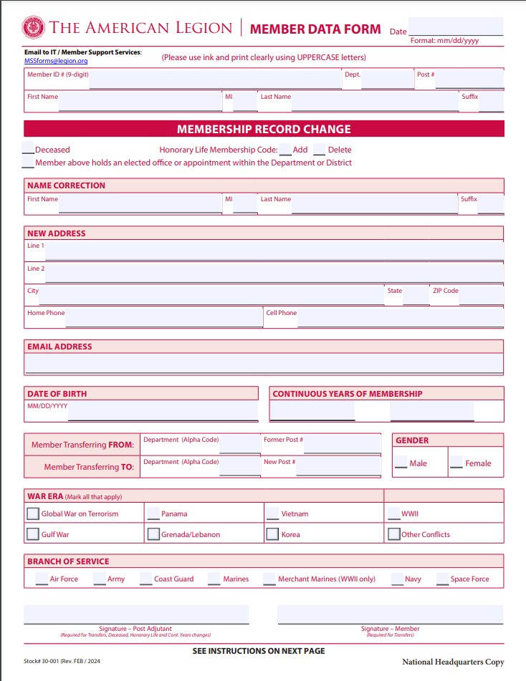
Membership Data Form
Notes:
Show Member Data Form

Slide 47
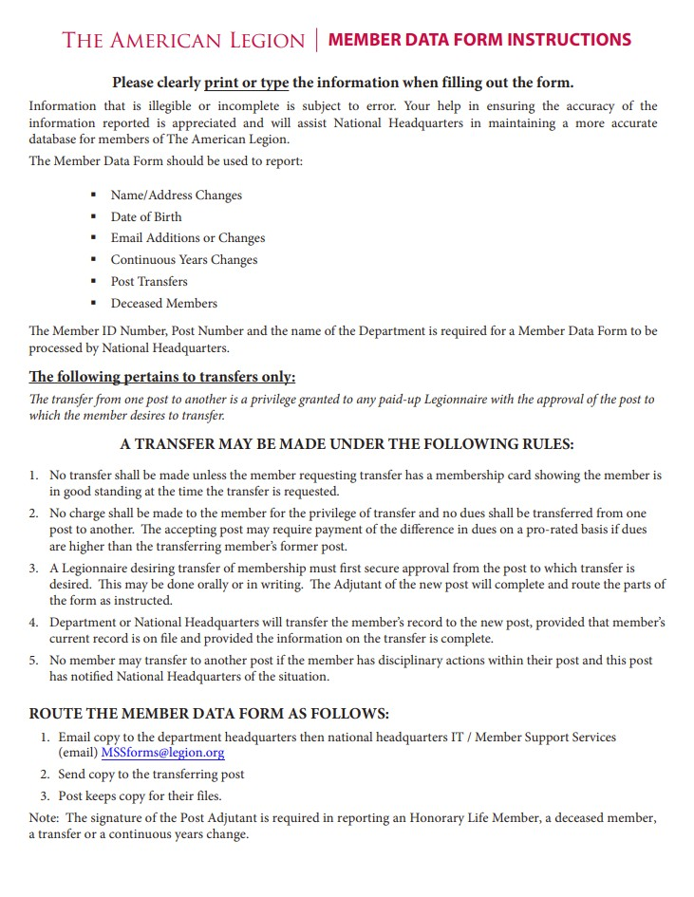
Membership Data Form
Notes:
AL is moving away from this form and prefers MyLetion.org form for updates
Quicker, copies are easier to read
Can be viewed at any time with laptop

Slide 48
MyLegion.org
Link
Two uses
Personal (Individual Member) Highly Recommend
Ability for members to update info directly
Can update the following:
Name/Demographics
Military Service
Contact Info
Addresses
Emergency Contacts
My groups (Key Officers)
Ability to update member info directly as Adjutant
Notes:
Mylegion.org has two key uses
Membership updates by members
Adjutant updates of membership info

Slide 49
MyLegion.org
Used to make updates immediately versus using member data form
Ability to update the same info that individual members can do
Mostly used to update info for members who are not computer literate or don’t have a computer
Need to register to use
Click on help link (on top of page)
Will explain how to register
How to use mylegion.org (members & Officers)
Click on how to use mylegion.org
Follow instructions
They have training presentations for each step
Notes:
Adjutant needs to register
Controls who has access

Slide 50
myLegion.org
Provides electronic means of processing and managing membership
Renewals, transfers, and new members
Update member info in real time
Print rosters and download to Excel for sorting
Reduces the time from Post completion to National receipt and processing
MyLegion.org Link
MyLegion.org Training Main Page Link
50
Notes:
Has electronic versions of most manuals mentioned today

Slide 51
MyLegion.org
Group Admin Tasks-Member Management

Slide 52
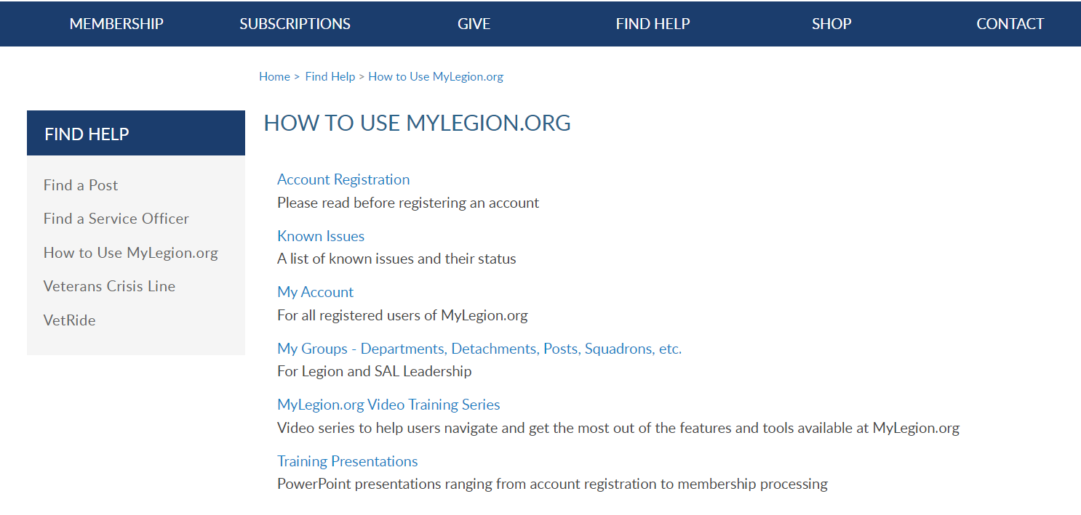
Online Help
52
Notes:
Step by step instructions, videos and training presentations will assist with how to manage your member account and groups in MyLegion.

Slide 53
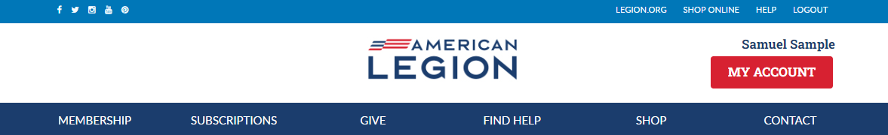
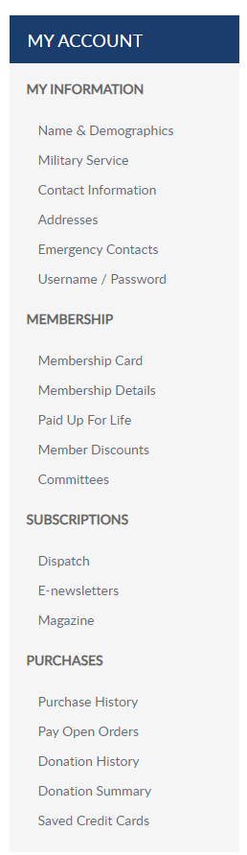
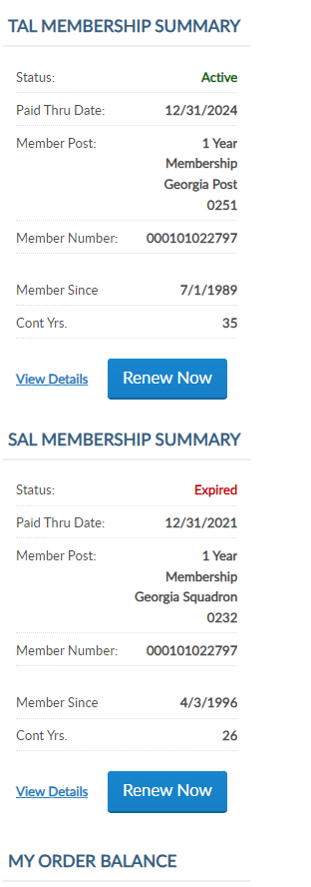
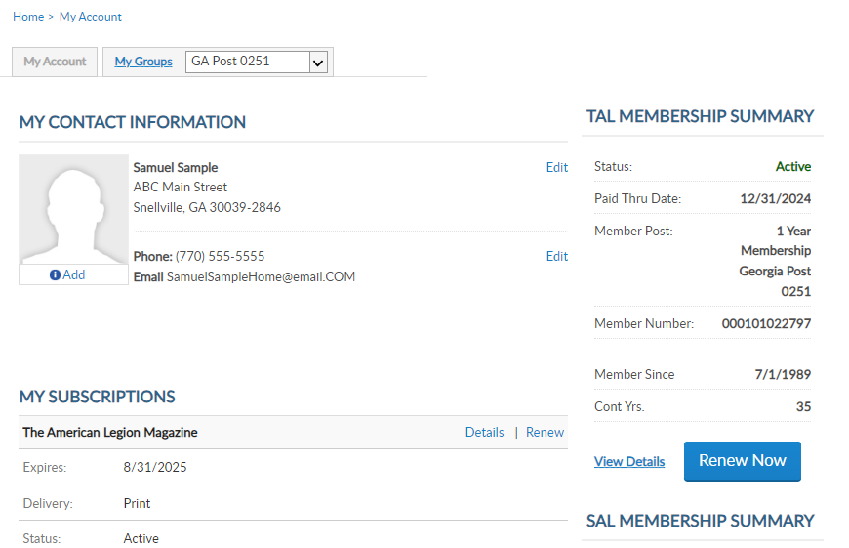
MYLEGION.ORG
My Account
Personal Member Info
My Groups
Adjutants & Commanders
Post, Squadron
District, County (View only)
Department, Detachment
Assigned Administrators
123456789
123456789
District 13 Santa Clara County
53
Notes:
When you log into MyLegion your My Account page displays information about your individual membership.
Adjutants and commanders of posts, squadrons, districts, counties, departments and detachments will have a My Groups menu when they are recorded in national’s membership system.
The group menu is related to your position as an adjutant and commander. Members who have been assigned permission by one of the administrative officers will also have a My Groups menu. My groups is the administrative side of myLegion.

Slide 54
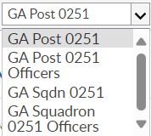
MYLEGION.ORG
My Groups Menu
Post Adjutant & Commander
Post
Post Officers (view only)
Squadron
Squadron Officers (view only)
123456789
123456789
District 13 Santa Clara County
54
Notes:
This member is a post adjutant and has 4 groups by default. <1> Legion leadership have access to both Legion and Sons of the American Legion groups. Officer groups are view only to see contact information for officers on file.
Clicking on the group will navigate you to the administrative side of MyLegion.

Slide 55
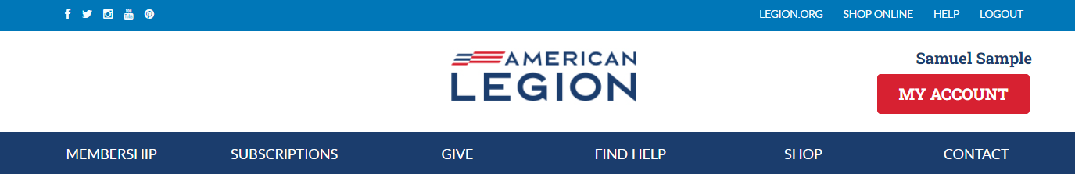
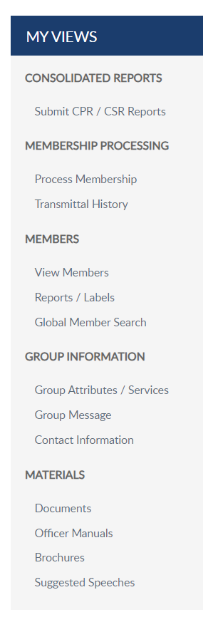
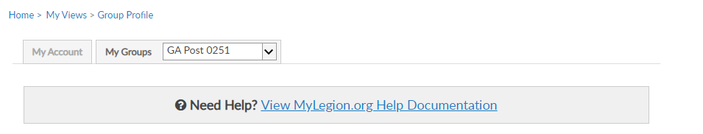
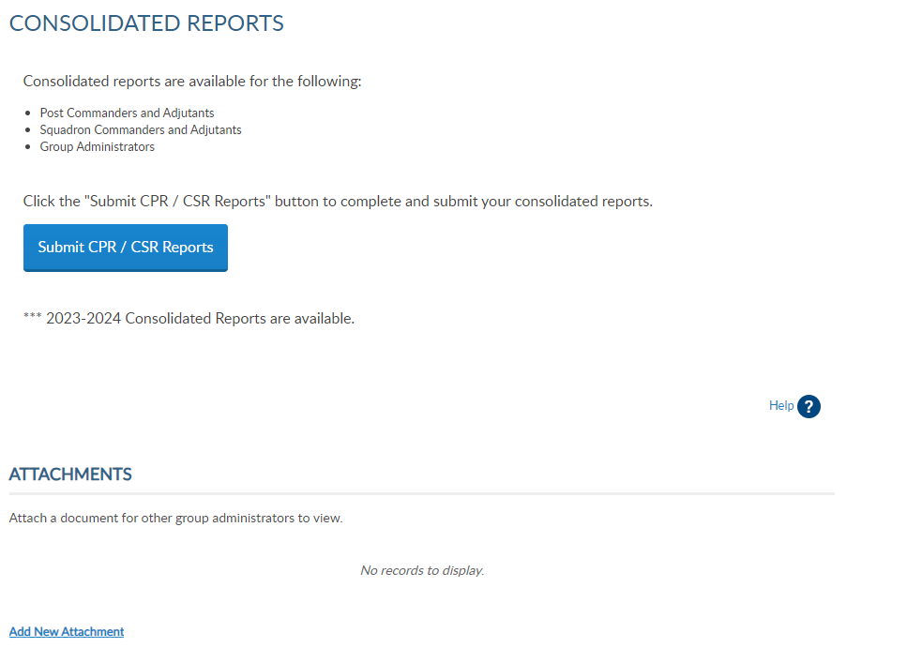
GROUP PROFILE
Consolidated Reports
Online CPR/CSR
Membership Processing
Renew, Add, Transfer
Members
View Members / Mbr Management
Reports
Group Information
Contact Information
Materials
Manuals, Brochures, Speeches
55
55
District 13 Santa Clara County
Notes:
The groups area has a left hand “My Views” menu with links to administrative tools. Consolidated reports, online membership processing, reports, member management, group information and officer materials.
<1> Click on View Members to view members in the group selected.

Slide 56
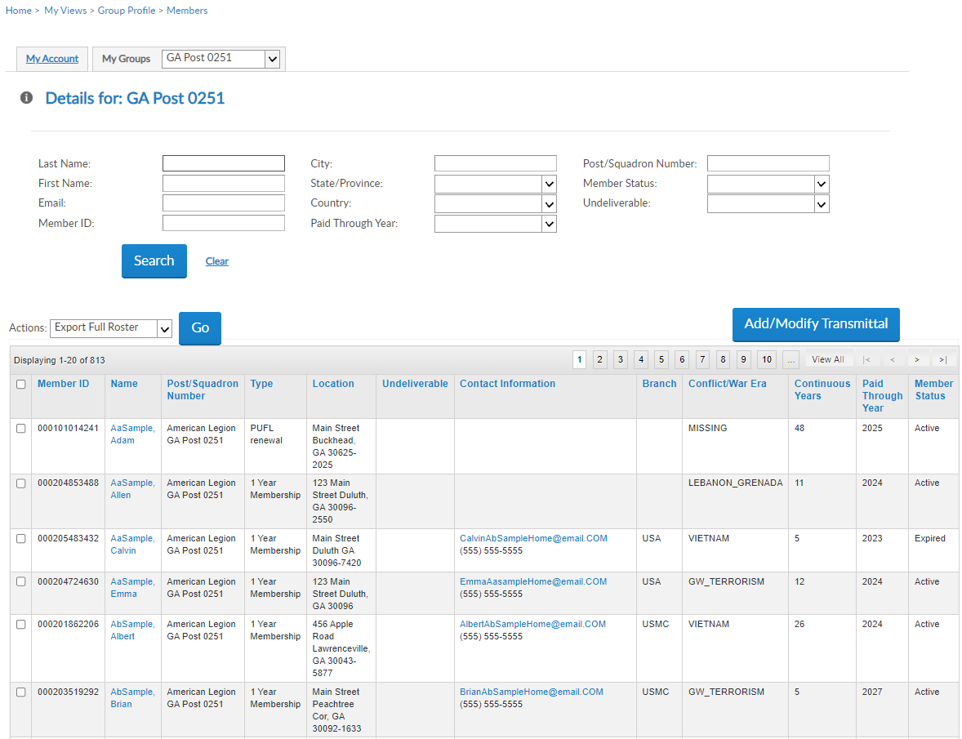
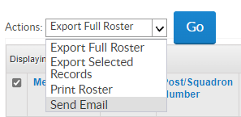
VIEW MEMBERS
View Members List
Contact Information
Member Status
Search Members
Reports located in another menu option Filter Options
Edit
Send Emails
Add/Modify Transmittal
Not available to districts and counties.
000123456781
000123456782
000123456783
000123456784
000123456789
**
000123456786
District 13 Santa Clara County
56
Notes:
View members includes current, deceased and expired members. It does not include members who have transferred out. View Member’s list provides a quick view of member contact information and status.
Search filters allow you to search a member or group of members. Do not use view members for reports. Reports are located in another menu option. To create a roster, return to group profile and go to Reports/Labels.​
​
You can click on an email address of an individual to send an email or filter a group to send a group email. When sending group emails, click “View All” to load the list on one page. Select all names by clicking the box in the title row. <1> Go to the actions menu and select “Send Email” and click Go.
The Add/Modify button is only available to posts, squadrons, detachments, and departments. It opens online membership processing. District and County access allows view only. District and County access will not include Add/Modify transmittal. Learn more about online membership processing in Find Help.

Slide 57
VIEW MEMBERS
000123456781
JohnZaSampleHome@email.COM
2025
Expired
000351234567
ZaSample, John
PO Box ABC
Duluth, GA 30096-2550
000123456782
000123456783
000123456784
000123456789
**
000123456786
57
Notes:
The member list includes all members of the post members since I am in the post group.
The view members list is alphabetical. Click on any of the title columns to resort and navigation icons to go from page to page. <1> New members in a pending transmittal will be in the list as expired with zero continuous years. When the transmittal completes the status updates to Active with 1 continuous membership year. ​
The view member list includes member contact and demographic information, last paid membership year and status. Members who have transferred out, will not be included in this listing. To view all members that have paid to your post, including those transferred out, go to Reports to generate a Paid Member Listing.​
​To edit member information, click on the member’s name. <2>
​
​

Slide 58
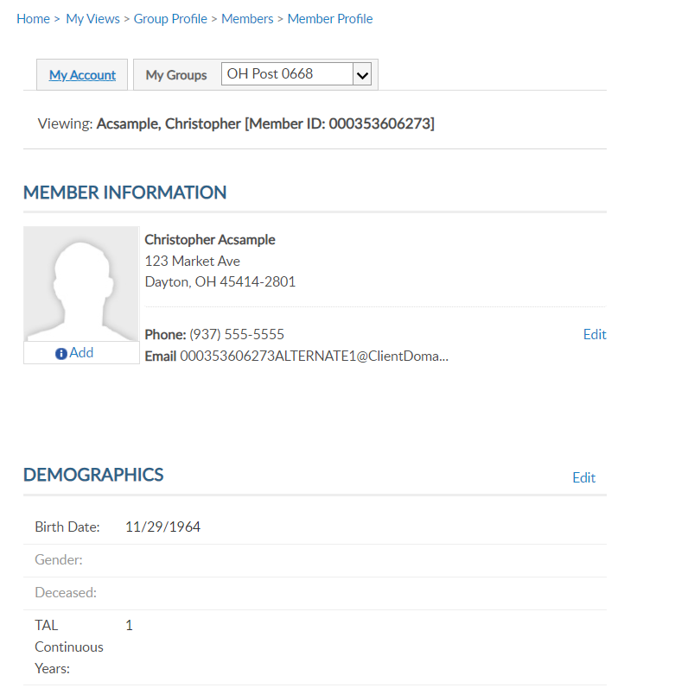
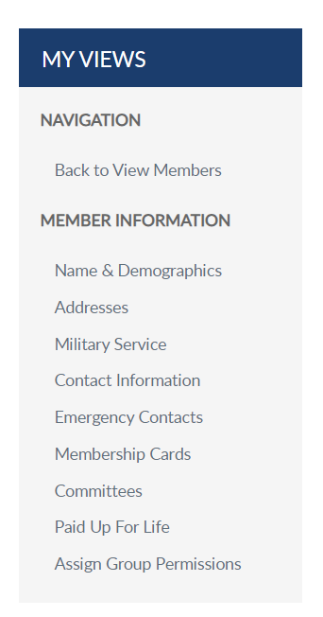
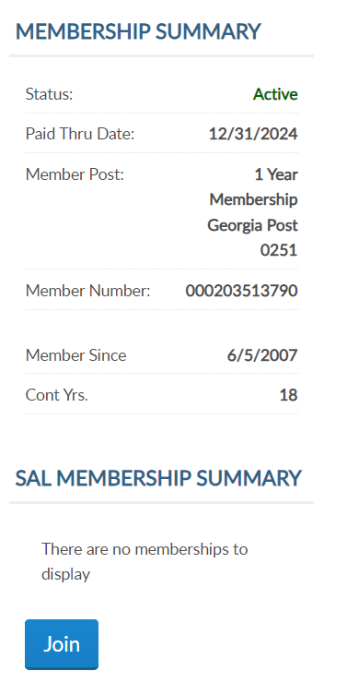
MEMBER INFORMATION
Viewing: AbSample, Albert [Member ID: 123456789]
Albert AbSample
456 Apple Road
Lawrenceville, GA 30043-5877
Phone: (555) 555-5555
Email: AlbertAbSampleHome@email.COM
000123456789
6/5/1998
26
26
District 13 Santa Clara County
58
Notes:
Viewing a member displays the member’s name, ID#, contact information, demographics, and membership summaries. For members of both The American Legion and Sons of the American Legion, both membership summaries are displayed. <1>Summaries include status, paid through year, membership type, and continuous years. The membership ID number is the same for both memberships.

Slide 59
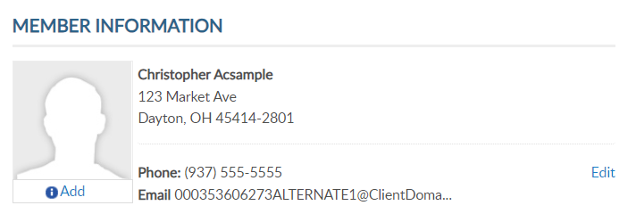
C0NTACT INFORMATION
Viewing: AbSample, Albert [Member ID: 123456789]
Albert AbSample
456 Apple Road
Lawrenceville, GA 30043-5877
Albert AbSample
456 Apple Road
Lawrenceville, GA 30043-5877
Phone: (555) 555-5555
Email: AlbertAbSampleHome@email.COM
Phone: (555) 555-5555
Email: AlbertAbSampleHome@email.COM
26
District 13 Santa Clara County
59
Notes:
Contact information includes phone number and email address. You can edit or add contact information by clicking the edit button in member information. You can also select the link from the side menu. <1>

Slide 60
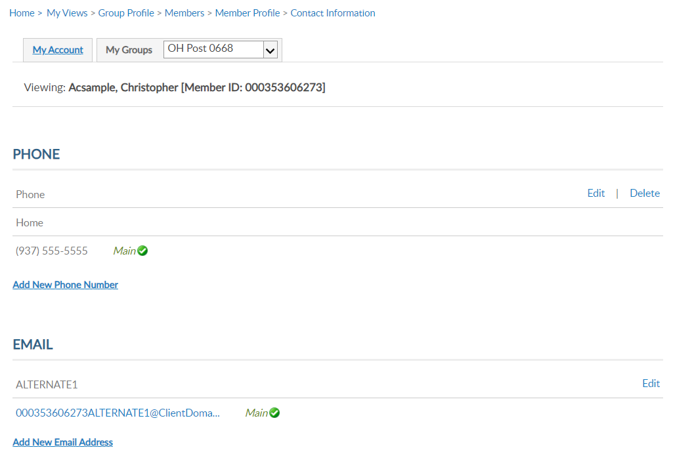
CONTACT INFORMATION
Viewing: AbSample, Albert [Member ID: 123456789]
Viewing: AbSample, Albert [Member ID: 123456789]
Albert AbSample
456 Apple Road
Lawrenceville, GA 30043-5877
(555) 555-5555
Phone: (555) 555-5555
Email: AlbertAbSampleHome@email.COM
HOME
AlbetAbSampleHOme@email.COM
26
District 13 Santa Clara County
60
Notes:
Contact information includes phone and email information. Using, edit, delete or add update as needed.
Member’s can have multiple emails and phone numbers. A total of 3 emails can be on a member’s record.
Updating the main email address updates the email associated with your myLegion account. All email communications for myLegion password and username are sent to the main email address.
If one email is on file, no delete option will be available. An email must exist on your record to have a myLegion account. In the event you do want to delete your email address, contact National MyLegion support staff.

Slide 61
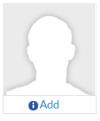
ADD / MANAGE IMAGE
Viewing: AbSample, Albert [Member ID: 123456789]
Albert AbSample
456 Apple Road
Lawrenceville, GA 30043-5877
Phone: (555) 555-5555
Email: AlbertAbSampleHome@email.COM
26
61
District 13 Santa Clara County
Notes:
Members and Administrative officers can upload a picture by clicking Add. <1>

Slide 62
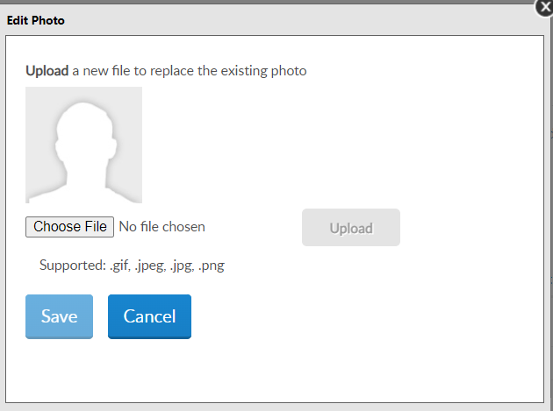
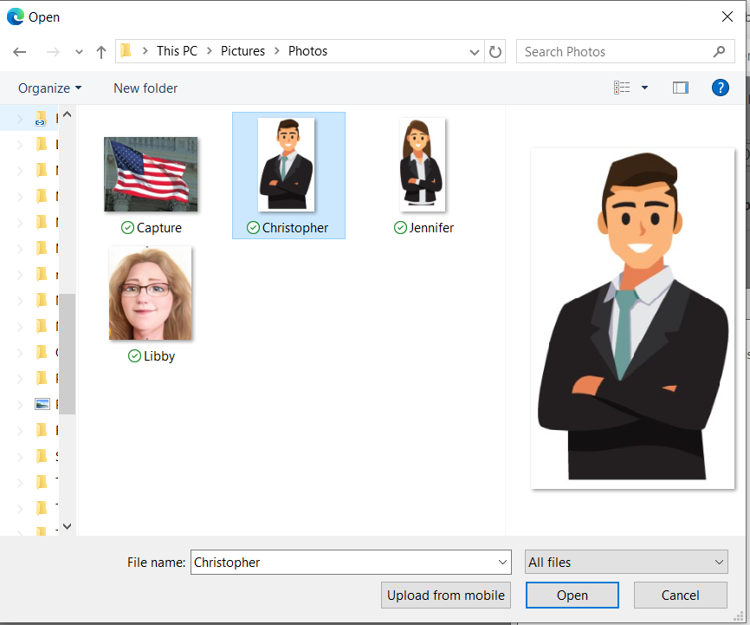
ADD / MANAGE IMAGE
Albert
District 13 Santa Clara County
62
Notes:
The edit photo window opens for you to choose your image to display. Only the supported file types can be selected. Select “Choose File” and <1>
locate the image file. Select the file and click Open. <2>

Slide 63
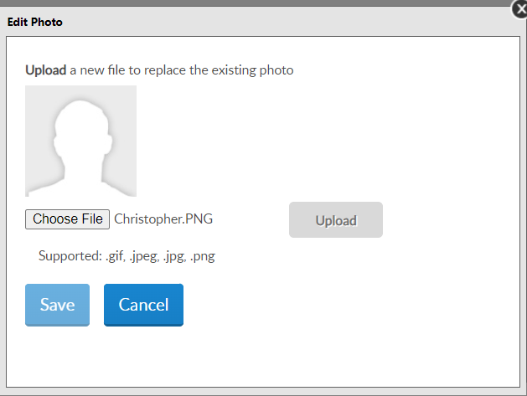
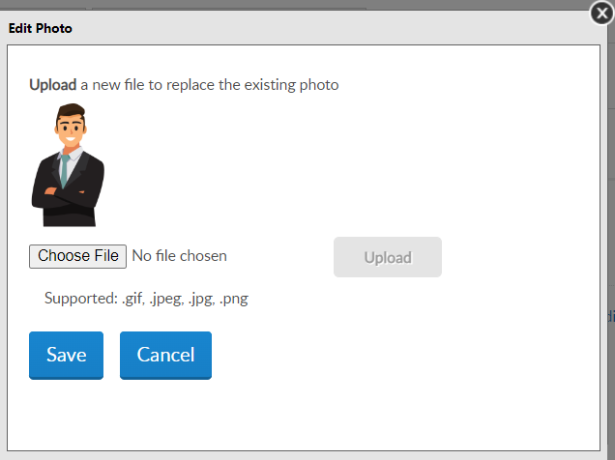
ADD / MANAGE IMAGE
Albert.PNG
District 13 Santa Clara County
63
Notes:
The file name appears. Select “Upload”. <1> The image displays. Click Save <2> to save image or cancel and no image will be saved on the member’s record.

Slide 64
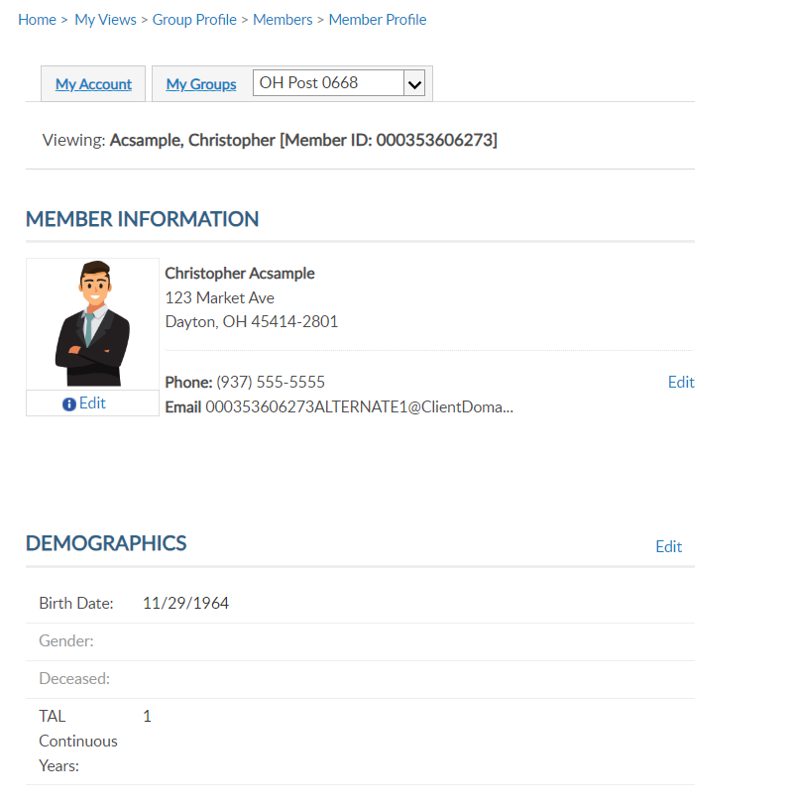
NAME & DEMOGRAPHICS
Viewing: Acsample, Christopher [Member ID: 123456789]
Viewing: AbSample, Albert [Member ID: 123456789]
Address update only.
Albert AbSample
456 Apple Road
Lawrenceville, GA 30043-5877
Phone: (555) 555-5555
Email: AlbertAbSampleHome@email.COM
26
District 13 Santa Clara County
64
Notes:
Once you add an image, you can edit or remove by clicking on Edit below the image.
The main view member information page and has edit links <1> to update address, phone number, date of birth, gender, deceased status and continuous years. The sections are separate. To update a member’s name, you must use the left menu option for Name & Demographics <2>.

Slide 65
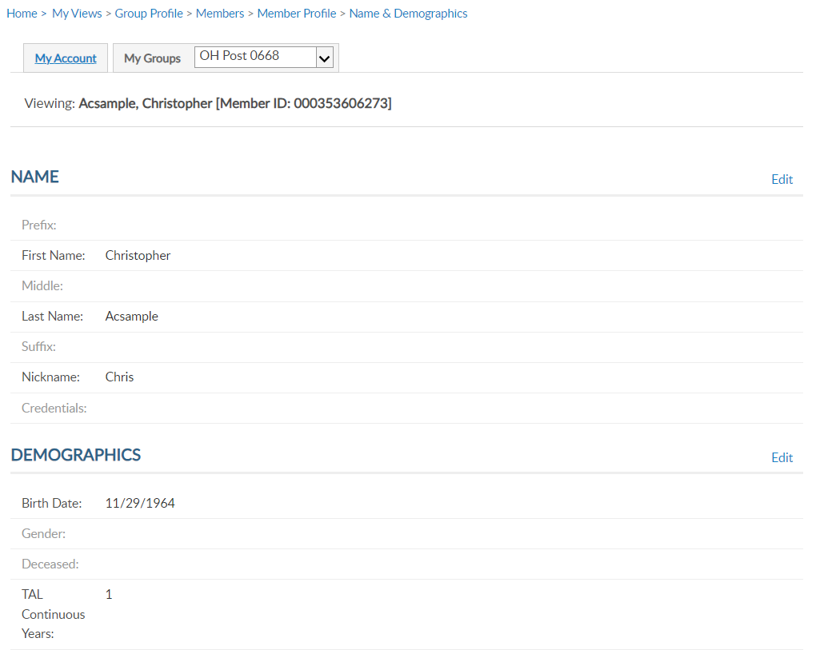
NAME & DEMOGRAPHICS
Viewing: AbSample, Albert [Member ID: 123456789]
Viewing: Acsample, Christopher [Member ID: 123456789]
Viewing: AbSample, Albert [Member ID: 123456789]
Albert AbSample
456 Apple Road
Lawrenceville, GA 30043-5877
Albert
AbSample
Phone: (555) 555-5555
Email: AlbertAbSampleHome@email.COM
Al
26
12
District 13 Santa Clara County
65
Notes:
This area has 2 sections, each with an edit button. Use the top edit button to edit name. Date of birth, gender, deceased status and continuous years can be maintained in Demographics. Click edit in the demographics section.<1>

Slide 66
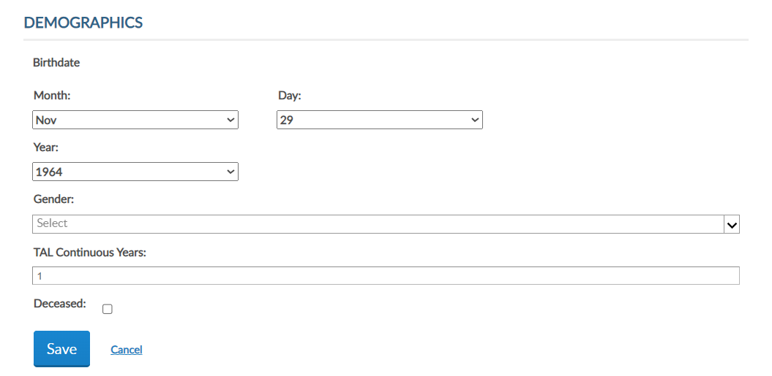
NAME & DEMOGRAPHICS
Viewing: AbSample, Albert [Member ID: 123456789]
Albert
AbSample
Al
26
26
District 13 Santa Clara County
66
Notes:
To update date of birth, gender, continuous years and deceased status, click on the Edit button in the Demographics area. <1> Enter updates and Save. Please note, you cannot remove deceased status through MyLegion. If a member is flagged as deceased in error, contact your department headquarters.

Slide 67

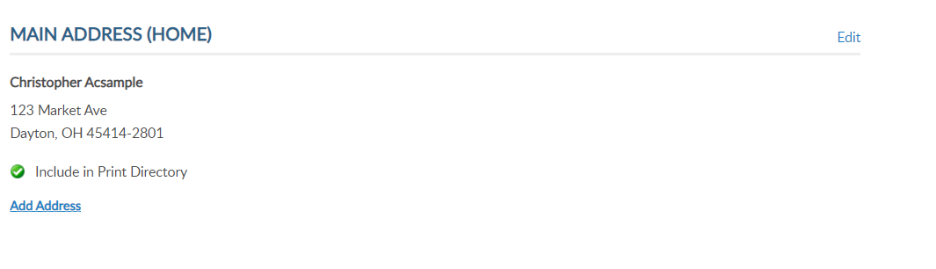
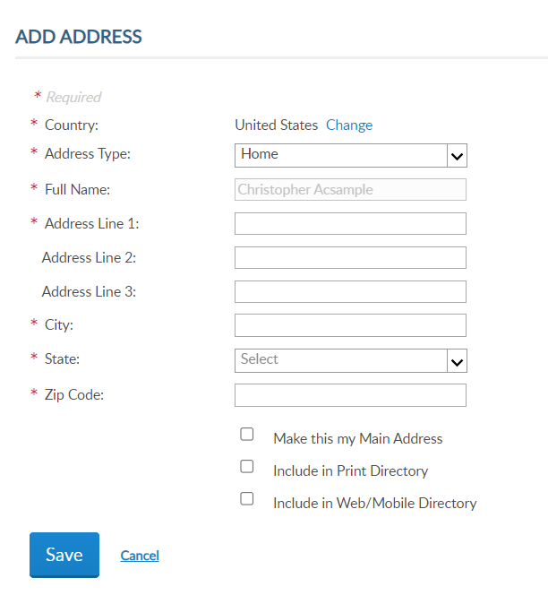
ADDRESSES
Viewing: Acsample, Christopher [Member ID: 123456789]
Viewing: AbSample, Albert [Member ID: 123456789]
Albert AbSample
456 Apple Road
Lawrenceville, GA 30043-5877
Albert AbSample
456 Apple Road
Lawrenceville, GA 30043-5877
Phone: (555) 555-5555
Email: AlbertAbSampleHome@email.COM
26
67
District 13 Santa Clara County
Notes:
Addresses allows you to update existing addresses or add an additional address to the member’s record. Members are required to have one main, or primary, address. The primary address listed on a member record determines where the address communications are sent for renewal notices, campaigns, and membership information. The main address cannot be deleted.
Some members may need an additional address on file for mailing subscriptions, or committee and officer correspondence. To add an additional address, click Add Address. <1> Selecting “Make this my main address” will make this your primary mailing address. Enter address information and save.

Slide 68
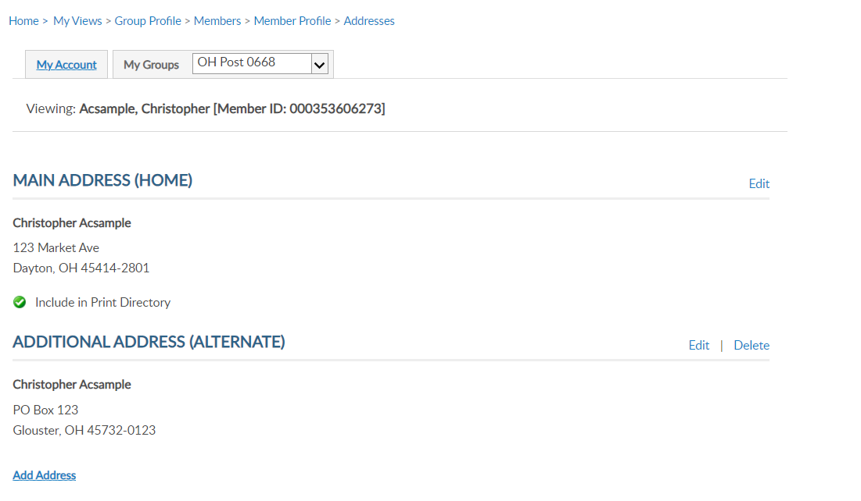
ADDRESSES
Viewing: AbSample, Albert [Member ID: 123456789]
Albert AbSample
456 Apple Road
Lawrenceville, GA 30043-5877
Albert AbSample
PO Box 123
Lawrenceville, GA 30043-5877
District 13 Santa Clara County
68
Notes:
The member record now has 2 addresses on file. Notice delete is now available. Delete only appears for alternate contact information.

Slide 69
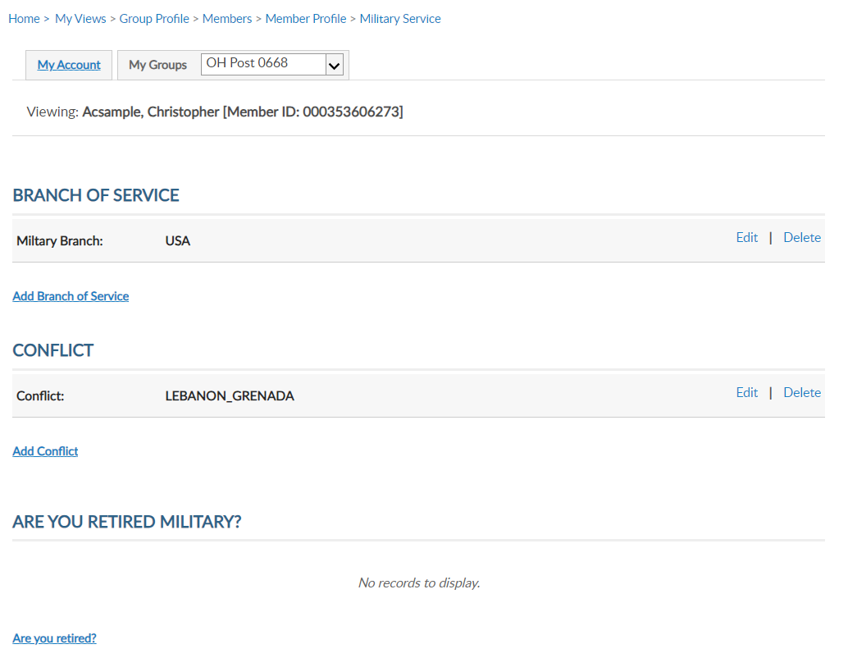
MILITARY SERVICE
Viewing: AbSample, Albert [Member ID: 123456789]
Viewing: Acsample, Christopher [Member ID: 123456789]
Viewing: AbSample, Albert [Member ID: 123456789]
Albert AbSample
456 Apple Road
Lawrenceville, GA 30043-5877
Phone: (555) 555-5555
Email: AlbertAbSampleHome@email.COM
26
District 13 Santa Clara County
69
Notes:
Military Service includes branch of service, conflict and retirement information.
MyLegion allows multiple selections to be stored on the member record. Use the links to Edit, Delete or Add branch of service and conflict.

Slide 70
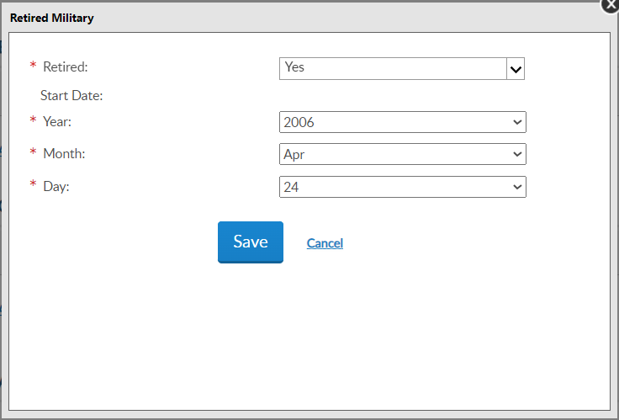
MILITARY SERVICE
Viewing: AbSample, Albert [Member ID: 123456789]
District 13 Santa Clara County
70
Notes:
You can also store retirement information. To add retirement information, click on the link Are you Retired? <1> Enter the date retired and Save.

Slide 71
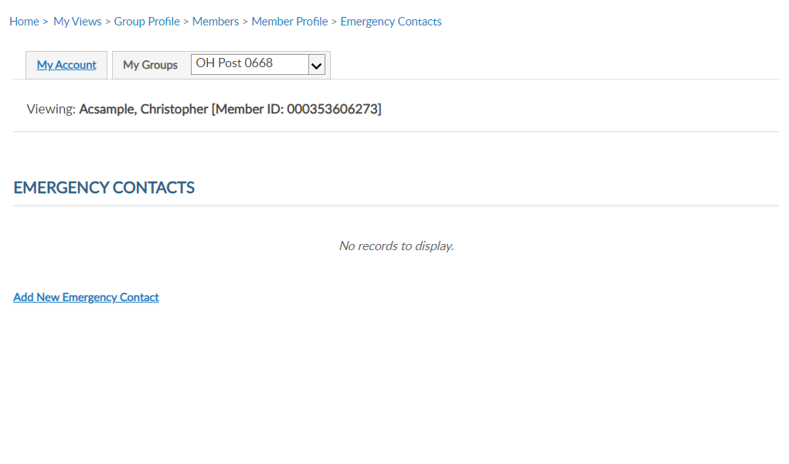
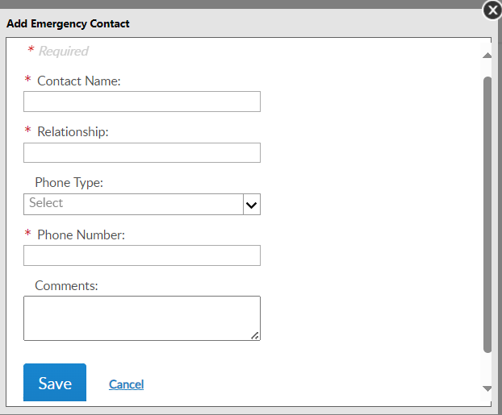
EMERGENCY CONTACTS
Viewing: AbSample, Albert [Member ID: 123456789]
Viewing: Acsample, Christopher [Member ID: 123456789]
Viewing: AbSample, Albert [Member ID: 123456789]
Albert AbSample
456 Apple Road
Lawrenceville, GA 30043-5877
Phone: (555) 555-5555
Email: AlbertAbSampleHome@email.COM
26
District 13 Santa Clara County
71
Notes:
Store emergency contact information in case of an emergency. <1> Enter emergency contact name, relationship, phone number, any comments and “Save”. - This information can be seen by department and national staff in case of an emergency if the member attends events and conventions or local activity of The American Legion or Sons of The American Legion.

Slide 72
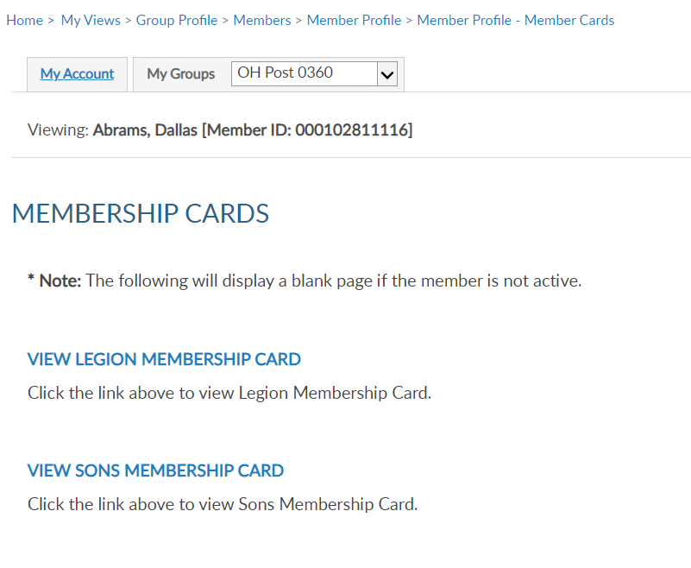
MEMBERSHIP CARDS
Viewing: Acsample, Christopher [Member ID: 123456789]
Viewing: AbSample, Albert [Member ID: 123456789]
Viewing: AbSample, Albert [Member ID: 123456789]
Albert AbSample
456 Apple Road
Lawrenceville, GA 30043-5877
Phone: (555) 555-5555
Email: AlbertAbSampleHome@email.COM
26
District 13 Santa Clara County
72
Notes:
Print a membership card for a member. Click “membership card”. <1> Members who have both Legion and Sons of the American Legion members will have 2 options. Only current membership cards are available. This page will display as blank if membership is not active. Click on the link to view and print a card.

Slide 73
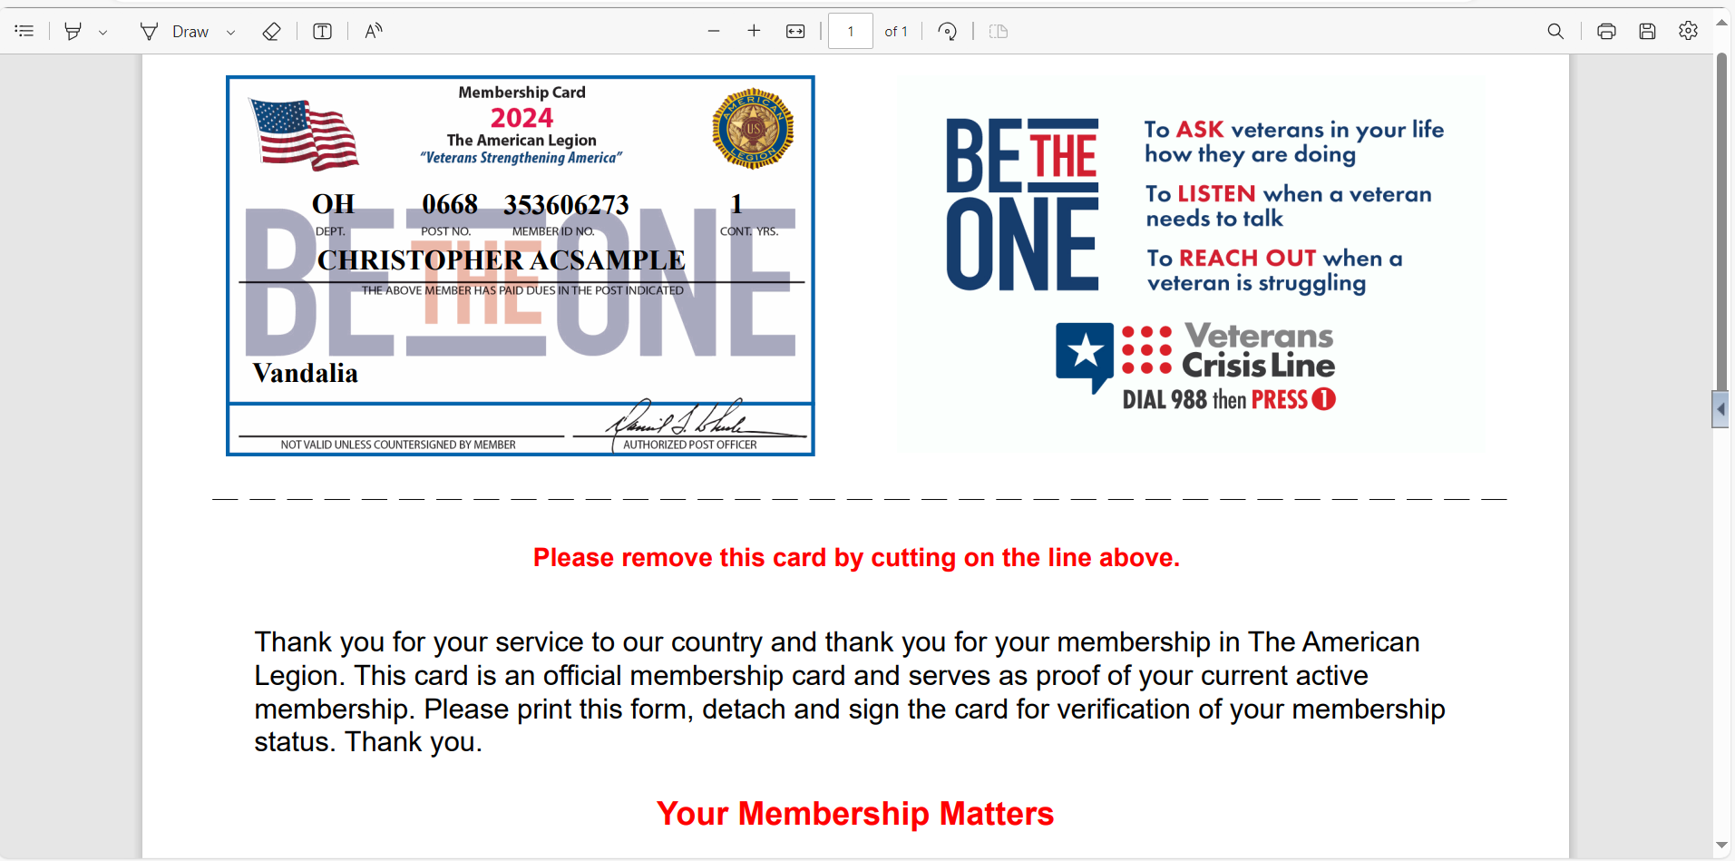
MEMBERSHIP CARDS
GA 0251 123456789 26
Albert AbSample
Duluth
73
District 13 Santa Clara County
Notes:
A pdf document will open in your browser to save or print. <1>

Slide 74
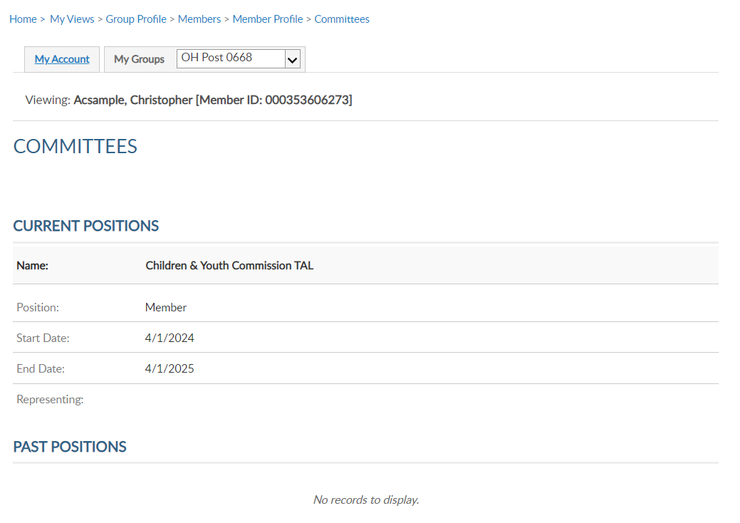
COMMITTEES
Viewing: AbSample, Albert [Member ID: 123456789]
Viewing: Acsample, Christopher [Member ID: 123456789]
Viewing: AbSample, Albert [Member ID: 123456789]
Albert AbSample
456 Apple Road
Lawrenceville, GA 30043-5877
Phone: (555) 555-5555
Email: AlbertAbSampleHome@email.COM
26
District 13 Santa Clara County
74
Notes:
Committees lists offices held that are recorded on National’s membership system. It will display current and past positions.
This area is view only and reflects officers reported to National HQs. Officer updates are reported through your department using a post officers certification form. Incorrect committee information should be reported to your department.

Slide 75
PAID UP FOR LIFE
Viewing: Acsample, Christopher [Member ID: 123456789]
Viewing: AbSample, Albert [Member ID: 123456789]
Albert AbSample
456 Apple Road
Lawrenceville, GA 30043-5877
Phone: (555) 555-5555
Email: AlbertAbSampleHome@email.COM
26
District 13 Santa Clara County
75
Notes:
Paid up for life allows you to assist members with the online application.
Members that are already PUFL and expired members, will result in an error. Proceeding through the application provide the cost for PUFL membership either paid in full or using the 12-month payment plan.

Slide 76
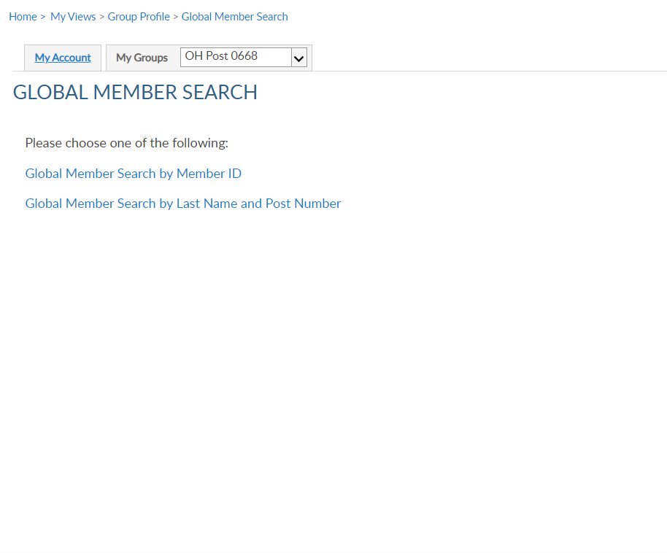

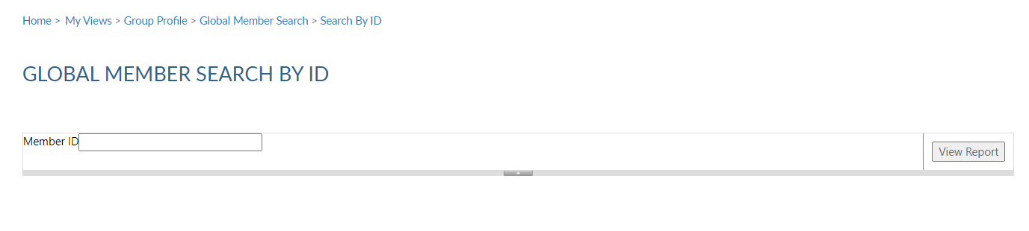
GLOBAL MEMBER SERACH
District 13 Santa Clara County
76
Notes:
Global member search allows you to view members outside of your group. 2 options are provided. Search by ID or search by name with post number.
<1> Search by ID allows you to enter a Legion or Son of The American Legion membership number to view limited information. Enter the ID#, click View Report <2> to view name, member type, paid post or squadron, and last paid year.

Slide 77
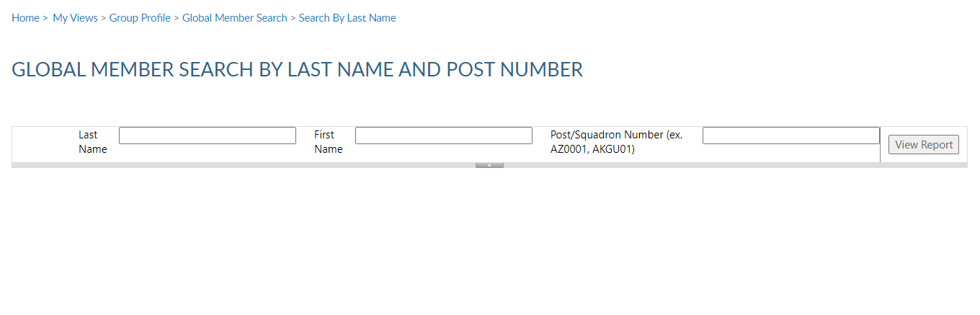
IMPORTANT INFO
District 13 Santa Clara County
77
Notes:
Search by name and number requires both pieces of information. Click View Report to view. <1>
This information can assist with transferring members and eligibility for The American Legion Auxiliary and Sons of the American Legion.

Slide 78
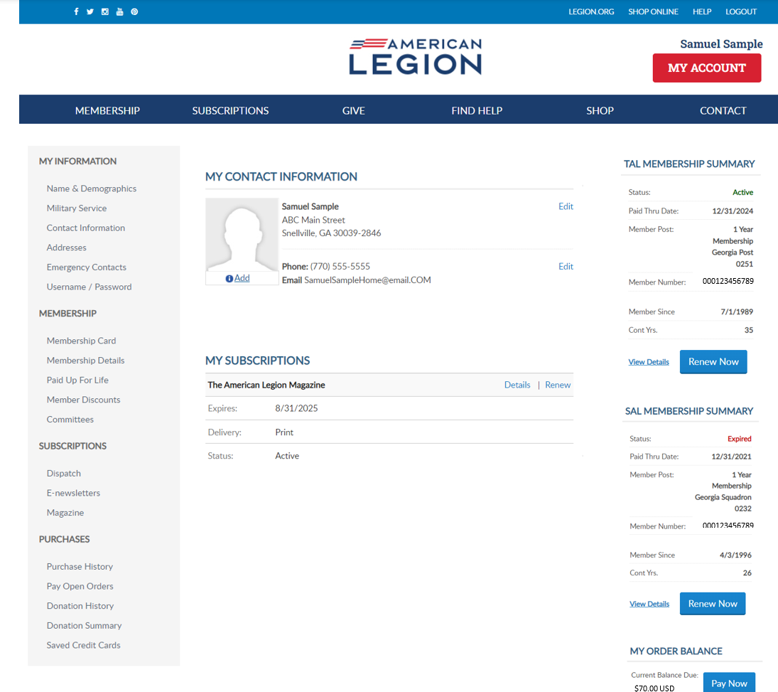
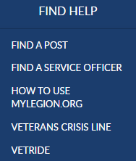
MY ACCOUNT & HELP RESOURCES
78
District 13 Santa Clara County
Notes:
Learn more about MyLegion using “Find Help” and go to How to use MyLegion.org.

Slide 79
Online Help
District 13 Santa Clara County
79
Notes:
Step by step instructions, videos and training presentations will assist with how to manage your member account and groups in MyLegion.

Slide 80
MyLegion.org
Group Admin Tasks-Reports
Notes:
Show Member Data Form

Slide 81
MYLEGION.ORG
My Account
Personal Member Info
My Groups
Adjutants & Commanders
Post, Squadron
District, County (View only)
Department, Detachment
Assigned Administrators
123456789
123456789
81
Notes:
When you log into MyLegion your My Account page displays information about your individual membership.
Adjutants and commanders of posts, squadrons, districts, counties, departments and detachments will have a My Groups menu when they are recorded in national’s membership system. The group menu is related to your position as an adjutant and commander. Members who have been assigned permission by one of the administrative officers will also have a My Groups menu. My groups is the administrative side of myLegion.
This member is a post adjutant and has 4 groups by default. <1> Legion leadership have access to both Legion and Sons of the American Legion groups. Officer groups are view only to see contact information for officers on file.
Clicking on the group will navigate you to the administrative side of MyLegion to access reports.

Slide 82
MY GROUPS: REPORTS
Consolidated Reports
Post (CSR)
Squadron (CSR)
Reports / Labels
82
Notes:
Reports available include Consolidated reports for posts and squadrons, membership reports, labels, and letters. Consolidated reports are not always available. After the deadline date, the report is closed, reviewed by national Internal Affairs division for revisions, and made available again for the next reporting year. During that time, you can still view previously submitted reports.

Slide 83
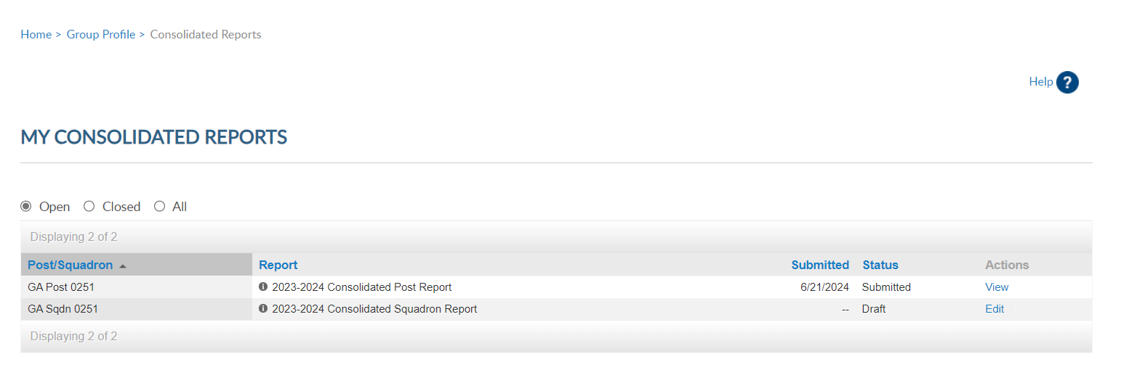
Open = Current Report
83
Notes:
There are 3 view areas in consolidated reports. Open includes current year reports.
Post adjutants have access to both reports. In this example the post report has been submitted. <1> You can click on View to open and print the report. Once submitted, you cannot make updates.

Slide 84

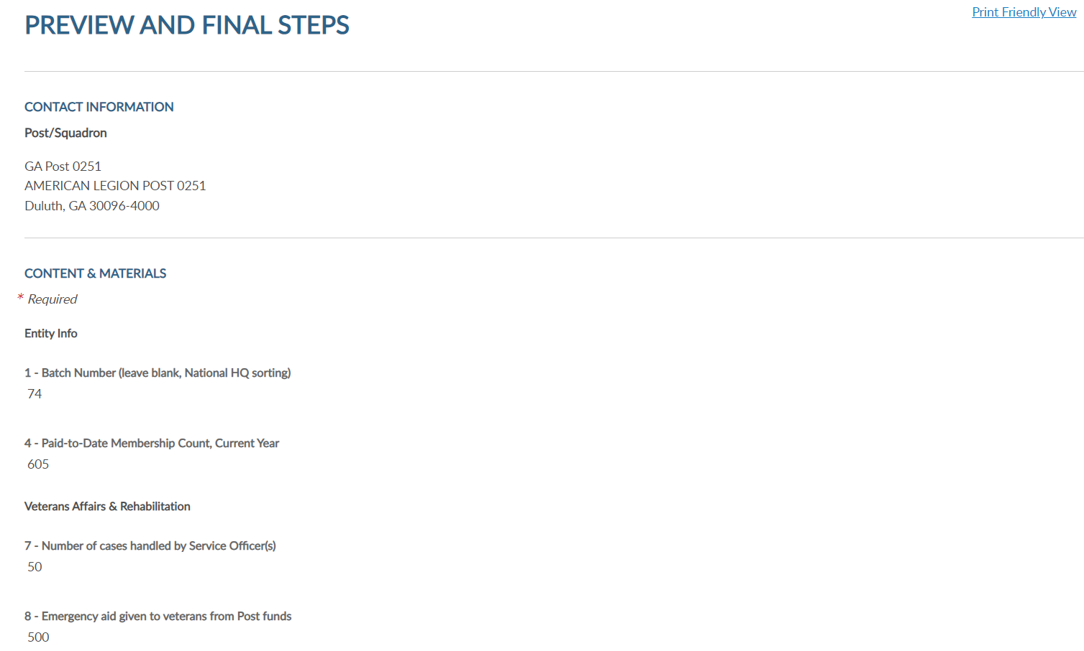
350
20
1500
84
Notes:
Click the link for printer friendly view to open the report in PDF to print. To return to consolidated reports click the breadcrumb link at the top of the page. <1>

Slide 85
Open = Current Report
85
Notes:
When the report is available for data entry, it will appear in draft status with Action set to Edit. The post report is submitted so let’s complete and submit the CSR. Begin by clicking Edit. <2

Slide 86
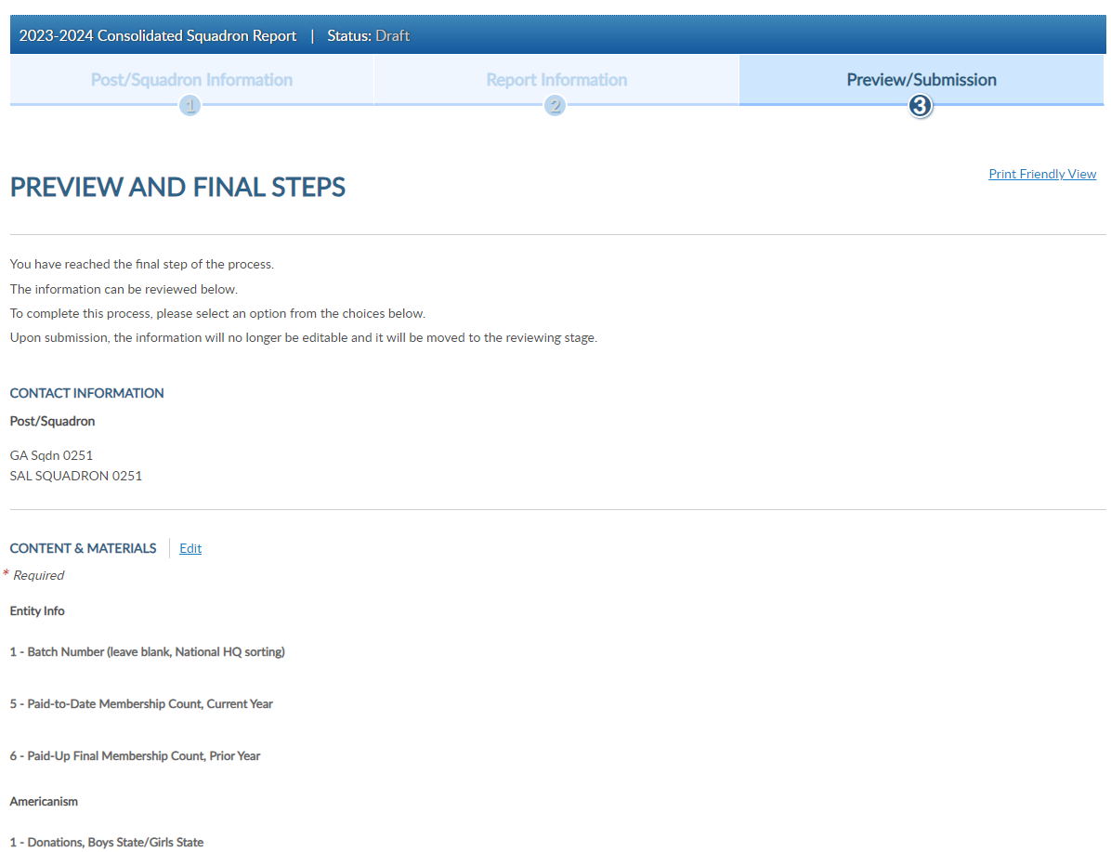
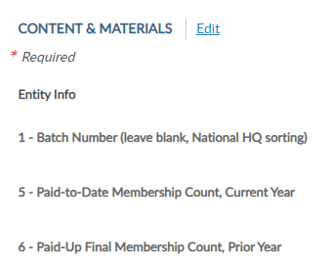
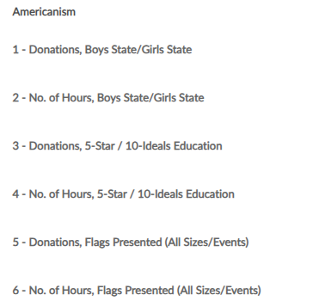
CONSOLIDATED REPORT
Edit to open fillable form.
86
Notes:
Click edit to open the fillable form. <1> Select Print Friendly View to Print the report at anytime. This allows you to print the report as a PDF document. Close the form to return to groups menu.

Slide 87
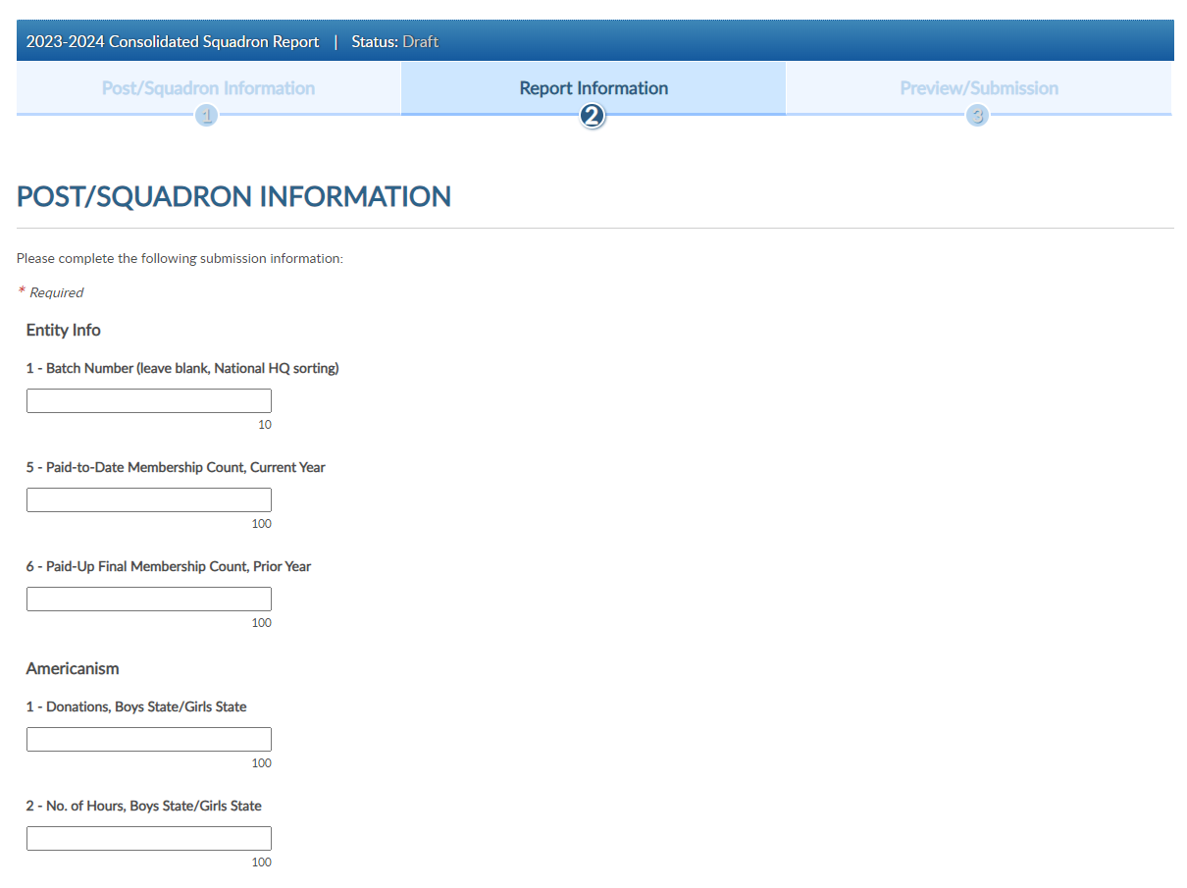
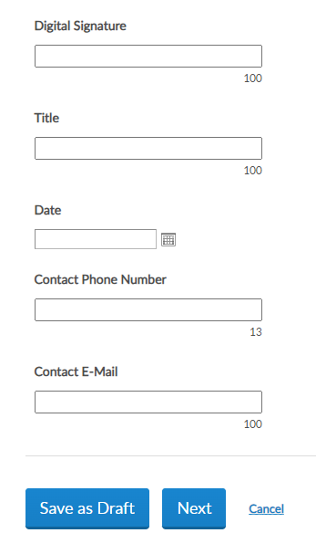
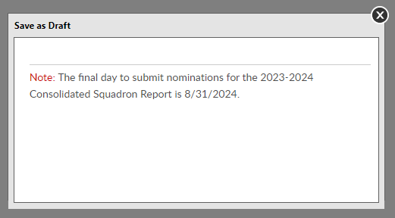
87
Notes:
Leave line one blank. This field is for national hq sorting. Enter data in the fields. The number of characters are identified by each box.
<1> continue through the form and at the bottom are options to save the form as a draft to continue later or click next to finalize.
<2> saving as a draft will display a message with the deadline date to submit online forms. After August 31, 2024 consolidated reports will be moved to closed status.

Slide 88


88
Notes:
To finalize the report, click Next <1> to view and select the Submit Final button. You will receive a notification the report is submitted.
Note, once the report is finalized it is saved as a submitted report. You will not be able to add data. If you plan to make additional updates, click Save as Draft and finalize by the due date.

Slide 89

CONSOLIDATED REPORT
Open Reports: View status = form submitted.
Do not send paper report if submitted online. Dept. receives copy of reports.
7/19/2024 Submitted View
7/19/2024 Submitted View
89
Notes:
Submitted reports will remain in the Open area with a submitted status until the report is closed for the year.
If you submit online, you do not need to mail a paper form. The department has access to submitted report data.

Slide 90

CONSOLIDATED REPORT
Closed: Previous Years, View Only
90
Notes:
Closed include reports from the 2020-2021 reporting years are available. Notice closed reports in draft mode only have view in actions. Reports were not submitted for that year.

Slide 91

GROUP PROFILE
Click “Group Profile” to return to MyGroups home page.
91
Notes:
Click on Group Profile to return to group administrative window and access other reports.

Slide 92
REPORTS / LABELS
Membership Rosters
Mailing Labels
HQ Member Lists
Renewal Letters/Labels
92
Notes:
Membership listings, roster updates, members renewed online, HQ member listings, mailing labels and a renewal letter are available through Reports/Labels.

Slide 93




POST / SQDN CURRENT ROSTER
Current Members
Active, Deceased, Expired
Members transferred out are not included Current Roster.
93
Notes:
Reports include post and squadron membership assigned to your group. To generate reports, you will first select the report and then the group and criteria. Let’s begin with a current roster report. This report includes current members of the post or squadron. Members who have transferred out, are not included in current membership. To view members who have paid to your post or squadron, generate a Paid Members report.
Click on the report name to proceed.

Slide 94



CURRENT ROSTER
Report Data Filters
Group – districts and counties will have all post/sqdns in their area.
Last Paid Year
Expired: 2022, 2023
Current: ≥ 2024
Paid Up For Life: 2025, 2026
Multi-Year Renewals: ≥ 2026
PUFL membership is rolled over on July 1 for the new campaign year and display LPY 2025.
LGN members paid for 2025 that purchase PUFL have LPY 2026.
94
Notes:
All reports are created using data filters. Filtering menus allow flexibility to the data included in the roster. The first field selected is Group. <1> Using the pulldown menu select the post or squadron to generate a report. District and county access will display a menu with all posts or squadrons in the area.
Next select last paid year. <2> Last paid year on a member’s record allows you to identify expired, current and future paid members.
<3> Legion members who are currently paid that purchase a Paid up For Life membership will also display a last paid year of which PUFL allotment will be due the post.
<4> American .Legion members who purchase a multi-year renewal will display the membership year they are paid through.

Slide 95




CURRENT ROSTER
Report Data Filters
LPY – Current
Status
Mailing Status
95
Notes:
In this example, the 2024 and all years greater are checked to capture all PUFL and multi-year paid members.
<1> Status includes active and deceased. Deceased members will remain on the roster and can be filtered out by selecting active only.
<2> The next filter is mailing status. Mail status let’s you know if the mailing address on file is good or flagged as undeliverable. Members with undeliverable status do not receive The American Legion Magazine, renewal notices, or any mailings from National Headquarters. Contact those members, if possible, to collect a valid mailing address and update. Updating an address that marked as undeliverable will remove the flag. If a member states the address on file is good, contact National Customer Service to remove the flag.

Slide 96





Navigation
Export
REPORT PROPERTIES
96
Notes:
The report generates. All reports provide navigation tools to allow you to go from page to page <1> , and to the first and last page. <2> There is a search filter to find specific data in the list. <3> Using the export Icon, export to an Excel document.

Slide 97


POST CURRENT ROSTER
97
Notes:
The roster includes status, paid year, contact information, conflict, continuous years, branch of service, date of birth and membership type. It also includes the total count at the bottom.
Members with asterisk have been flagged with an undeliverable address. <1> They will not receive renewal notices, subscriptions, or publications if they have an undeliverable address.

Slide 98
PAID MEMBER BY POST/SQDN
Department Goals/Awards
Paid / Mbrship Year
Includes paid members who have transferred out.
98
Notes:
The Paid Members report is the report corresponding with Department membership reports. It includes all members paid for the current year, even if they transferred out.
.

Slide 99




PAID MEMBER BY POST/SQDN
Data Filters
Organization
Post/Squadron
Last Paid Year
A member that joins through the national DMS program is placed into a HQs post and dues are encumbered (AD) to national HQ until the member renews twice or is transferred to a local post.
99
Notes:
This report includes encumbered and unencumbered HQ transfer members. Check with your department to se what counts toward annual membership goals. A member that joins through the national DMS program is placed into a HQs post and dues are encumbered (AD) to national HQ until the member renews twice or is transferred to a local post.
Report filters begin with organization, The American Legion or Sons of the American Legion. group, and last paid year. This report may be slow to load.

Slide 100


PAID MEMBER BY POST/SQDN
2024 Paid Members
Export:
PDF
Excel
100
Notes:
In this example we will pull a 2024 paid members report. Export the report to Excel. <1>

Slide 101

PAID MEMBER BY POST
Current Roster
101
Notes:
This report provides members paid to the post, even if transferred out. It also identifies the renewal type and batch number. The paid members report will correlate with department membership goals reports.
<1> The report may differ from your roster total. Use the roster update report to view members who have transferred out of the post.

Slide 102

ROSTER UPDATES
Data Updates:
Address Updates
Deceased
Transfer in/out
New Join
102
Notes:
The next report is Roster Updates. This report identify updates on a member record. Data updates can be made my members, local and department leadership, and by national customer service requests. View address updates, deceased notifications, members who have transferred in and out ,and new joins.

Slide 103

Updates to member information for address, deceased status, transfer information and new members (new join).
ROSTER UPDATES
103
Notes:
Select your group first. Using date range and update type you can produce various results. Want to see who transferred out this membership year, select transfer out only. You can pull a list of all members marked as deceased, identify new joins, and address updates.
After all filters are set View Report to generate. <1>

Slide 104


104
Notes:
The report gives you information on updates made to the member record. Notice transfer information includes to and from information. Members who transfer out of your post no longer appear in current roster or current membership reports. Paid members who transfer out will be included in the Paid Members report.

Slide 105

3 X 10 LABELS
Standard 30/sheet labels.
105
Notes:
3x10 labels produce a 30 per sheet label that fits Avery 5160 or any 30/sheet blank labels.

Slide 106


LABELS
30 per sheet mailing labels for LGN and SAL members.
106
Notes:
Filtering options allows you to define the members included in labels. Deceased and members flagged as undeliverable will be suppressed from mailing labels.
The first step is to select the group. Next, select the last paid year or multiple years. <3> Designate if you want your labels sorted by last name or zip code.
After parameters are set, View Report to continue. <1>

Slide 107


LABELS
30 per sheet mailing labels for LGN and SAL members.
107
Notes:
The label display is not in 30/sheet format. Send the data to a PDF document selecting the export icon. <1> The export icon is used print and save all reports using the file types in the menu. PDF is the only selection that applies for labels. After you select PDF look for a tab to open the PDF generally located at the lower left of your window.

Slide 108


108
Notes:
The PDF opens to print labels. <1> Use the print icon to send to your printer.

Slide 109

MYLEGION ACCESS
Monitor who has access to MyLegion for your group.
109
Notes:
Monitor who has access to your group in MyLegion using the MyLegion Access report.

Slide 110


MYLEGION ACCESS
Post /Squadron
District/County
110
Notes:
The group menu displays who you have access to maintain. District and county administrators will have a listing of all posts or squadrons in your group. . <1> Click View Report to see the list. <2>

Slide 111


111
Notes:
Adjutants and Commanders will have access by default and have access to manage permissions. To update permissions, search the member record and go to Assign Group Permissions.

Slide 112


ASSIGN GROUP PERMISSIONS
GA Post 0251
Viewing: AbSample, Albert [Member ID: 123456789]
District 13 Santa Clara County
112
Notes:
Assign group permissions should be used with caution. This tool allows adjutants and commanders to grant access to post and squadron membership to other members.
Our Post uses this to add First Vice Commander/Membership Officer so that they can do the membership transactions and free up the Adjutant to perform other functions
To add, delete or edit management settings, click edit. <1>

Slide 113
ASSIGN GROUP PERMISSIONS
GA Post 0251
Online Group Manager
Minimum Requirement
View and print member list.
Quick link to email address.
District 13 Santa Clara County
113
Notes:
To provide the same access adjutants and commanders have select:
Online Group Manager. This is the minimum permission requirement. It provides access to view members and a quick link to member email addresses. Selecting this option only results in view only and records cannot be updated.

Slide 114
ASSIGN GROUP PERMISSIONS
GA Post 0251
Edit Individual Profile
Edit member information
Edit Group Profile
Online Membership Tools: View Members, Global Member Lookup, Group Attributes, Reports/Labels, and Officer Materials.
District 13 Santa Clara County
114
Notes:
Check Edit Individual Profile to grant authority to add and edit member information. <1> Edit Group Profile provides access to View Members, Global Member Search, Group Attributes. Reports, Letters, Labels and Officer Materials.

Slide 115
ASSIGN GROUP PERMISSIONS
GA Post 0251
Register or Order for a Group
Allows online membership processing, Add/Modify Transmittal.
Identity Group Manager
ADJUTANTS AND COMMANDERS ONLY.
District 13 Santa Clara County
115
Notes:
Register or Order for a group isthe setting to allow other members to process membership online using Add/Modify transmittal. This permission allows the member to renew, transfer and add new members as well as update payment information.
<1> The last setting is only available to adjutants and commanders. This setting allows the member to provide management settings for other members.
After the desired management settings are assigned, click on the Save button.

Slide 116

ASSIGN GROUP PERMISSIONS
Viewing: AbSample, Albert [Member ID: 123456789]
* Monitor access using MyLegion Access report.
* Contact department headquarters to add end date.
District 13 Santa Clara County
116
Notes:
Permissions added will display. The next time the member logs into their myLegion account, they will have access to group membership. Notice I am in the post group. Permissions are set for post group only. To give permission to squadron membership, go to the squadron group first, find the member, and set permissions.
Select back to view members to search more names or select Group Profile to return to the group home page.
No end date is set when applying these permissions. Permissions can be removed by returning to Edit and unchecking the selections. It is important to keep track of anyone given permissions.
<1> You can monitor members with access to your group in MyLegion in reports. Learn more about reports in Find Help. <2> To ensure members with permissions are monitored we suggest you contact your department headquarters or MyLegion support team to add an end date. Adding an end date will remove permissions to allow any new officers or existing officers to review the members administrative needs and re-assign if needed.
<3> Click Back to View Members to return to the member listing.

Slide 117
MY ACCOUNT & HELP RESOURCES
117
Notes:
Learn more about MyLegion using “Find Help” and go to How to use MyLegion.org.

Slide 118

myLegion.org
118
Notes:
View of the various training presentations on MyLegion.org

Slide 119
Course Wrap-up
An effective Adjutant can provide stability and continuity to a Post
An effective Adjutant must know more than the basic administrative tasks of the job
Should know the Post history
Should know about County, District, and Department organizations, activities, and resources
119
Notes:
Start with honesty and willingness – training, knowledge, and help can be gotten from a number of sources
Prior post/county/district adjutants

Slide 120
The Post Adjutant
In many ways, the Post Adjutant is often the most important position to ensure the success of a Post in implementing Legion programs
120
Notes:
Be the leader that every Post needs – You CAN make a difference

Slide 121
Contact your department or national MyLegion support to assist with any questions or help with MyLegion.
MyLegion@legion.org
833.253.9995
Monday – Friday
8:00am – 4:30pm
(Eastern)
121
Notes:
Contact your department or national MyLegion support to assist with any questions and help with MyLegion.

Slide 122

Questions?
122

Slide 123
References
Material for this presentation was obtained from the following American Legion sites and locations
American Legion National Training Site
MyLegion.Org
American Legion Department of California Training Site and Reports Section
American Legion Adjutants Manual
American Legion District 13
123

